Slide 1
Conceptual and Methodological Issues in Evaluating Multidimensional Visualizations for Decision Support
Evanthia Dimara, Anastasia Bezerianos, and Pierre Dragicevic

Slide 2
Goal of Study
In this study the objective is to evaluate which visualization tools are best for decision making support.
Decision-making tasks can be error prone, and people tend to make irrational choices even when the data is properly understood.
This study explores how common visualizations can benefit a broad range of users without prior training in decision analysis.
Authors attempt to bridge the gap by exploring conceptual and methodological issues in evaluating how well visualizations can support decision-making tasks.

Slide 3
Multi-Attribute choice tasks
A common type of decision making task
For this experiment it is defined as “A task that consists of finding the best alternative among a fixed set of alternatives, where alternatives are defined across several attributes.”
All choice alternatives are known in advance and are defined across a set of attributes.
Generally involve user’s personal preferences and rarely has an obvious “right” answer.

Slide 4
Multidimensional visualization tools
The authors were tasked with choosing commonly used, elementary lossless geometric projection visualizations.
Final decision was Parallel Coordinates, Scatterplot Matrix, and Tabular Visualizations.
Evaluation methodology of tools relied on two major principles:
Each visualization tool should include all features that are considered the standard for it.
Each visualization is kept as comparable as possible through consistent visual design, consistent interaction design, and by having all interactions present the same amount of information across visualizations.
Visualization tools were to be compared to see how well they can support basic data exploration, and decision making.

Slide 5
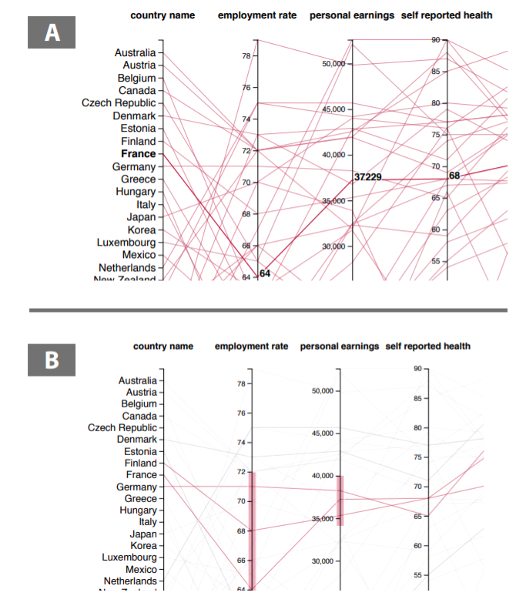
Visualization tools used
Parallel Coordinates

Slide 6
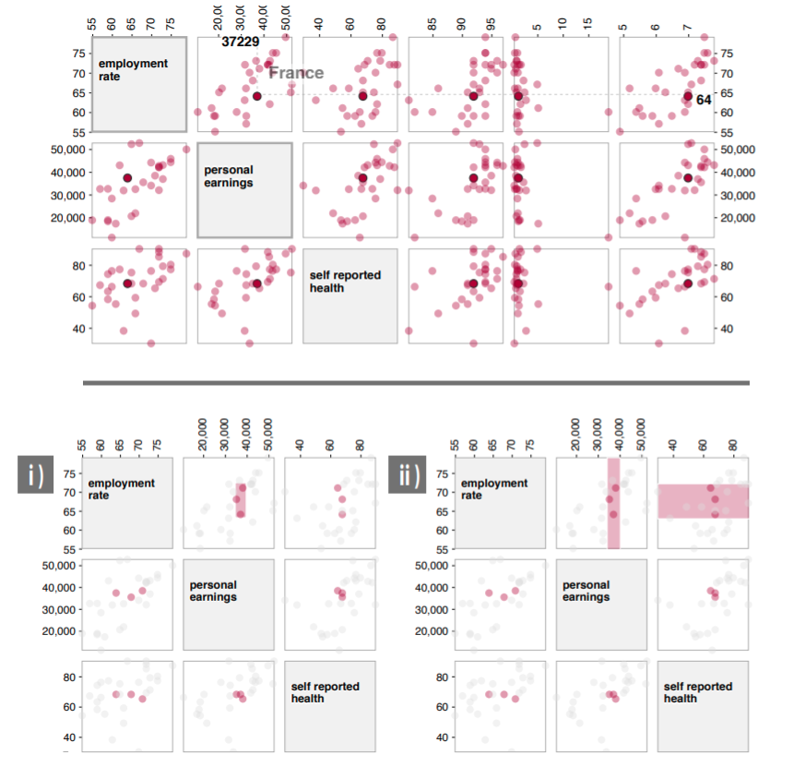
Visualization tools used
Scatterplot Matrix

Slide 7
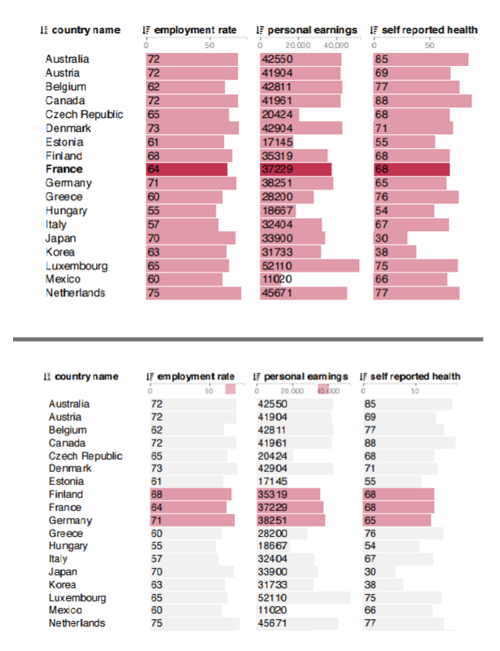
Visualization tools used
Tabular Visualization

Slide 8
Research questions
The following research questions were posed focusing on accuracy, time-on-task, subjective preference, and subjective choice assessment:
Q1. How do the three techniques compare in terms of accuracy in analytical tasks and in decision tasks?
Q2. How do the three techniques compare in terms of speed in analytic tasks?
Q3. Which technique people prefer over all for analytic tasks and decision tasks?
Q4. How do the three techniques compare in decision tasks in terms of choice, satisfaction, confidence, easiness, and attachment?

Slide 9
Experiment tasks
The core of the data collection is a dual evaluation which consists of the following four tasks:
Analytical:
Value Retrieval: Participant identifies the alternative of a specific attribute value, and then identifies the values of it’s attributes.
Range: Participant finds how many alternatives contain a chosen attribute X within a given range, and then how many alternative contain a chosen attribute Y within a given range.
Correlation: Participants find a pair of attributes that have the strongest correlation.
Decision: A multi-attribute choice task where the participant finds the best alternative among a fixed set of alternatives.

Slide 10
Experiment Procedure
At the beginning of the experiment participants were trained on how to read and interact with the tools for each visualization type.
Then using the experiment tasks, the experiment is split into an analytical session were participants engaged in analytical tasks, and a decision session.
After each decision task for each visualization type, the participants evaluated the choice they made using the following criteria:
Satisfaction
Confidence
Easiness
Attachment

Slide 11
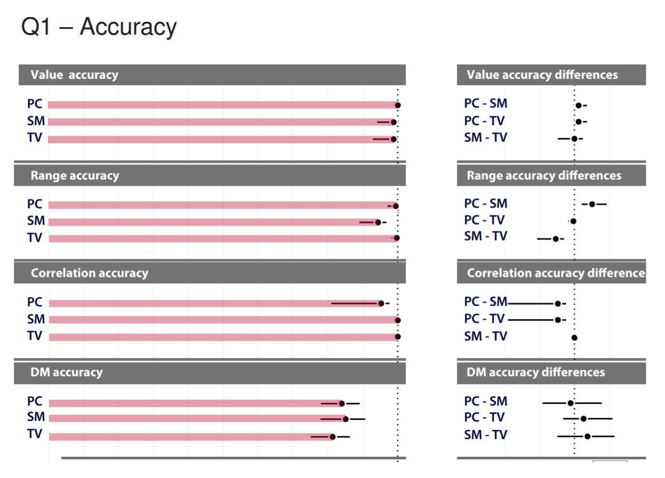
Experiment results – Accuracy
The first three horizontal panels report accuracies for the analytic tasks, and the bottom panel shows accuracy for decision task.
Bar chart shows mean accuracy.
Dot plot shows the mean differences in accuracy.

Slide 12
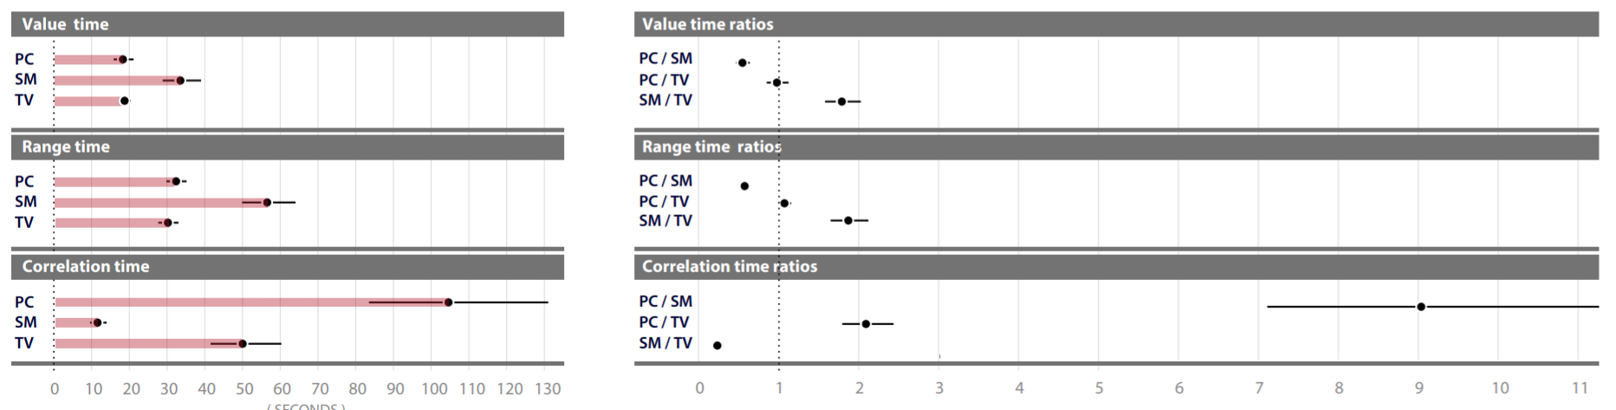
Experiment Results – Analytic Time-on-task
Top horizontal panel reports completion times for the value retrieval task.
Participants were much slower on average with Scatterplot Matrix in the value and range task.
For the correlation task the Scatterplot Matrix performs significantly better.

Slide 13
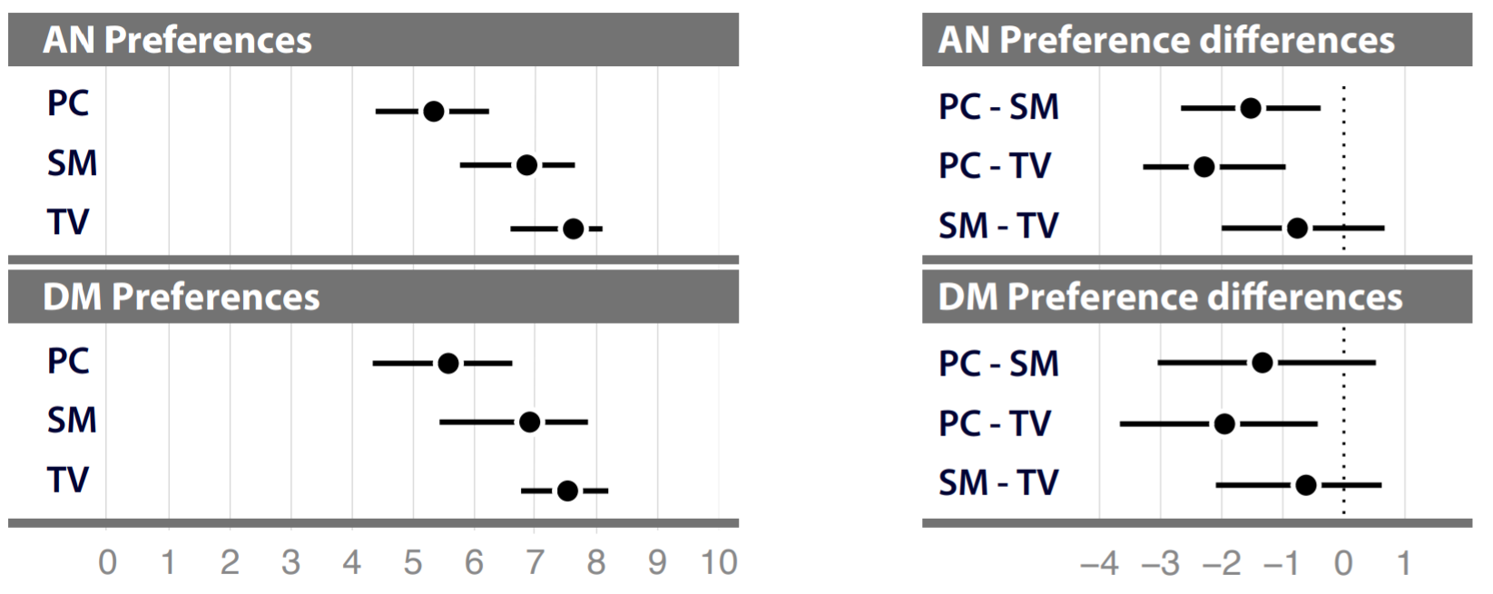
Experiment results – Subjective preference
Top horizontal panel show results for analytic tasks, and bottom panel shows results for decision task.
For analytic tasks, Parallel Coordinates were least preferred.
For decision making, participants preferred Tabular Visualizations over Parallel Coordinates.

Slide 14
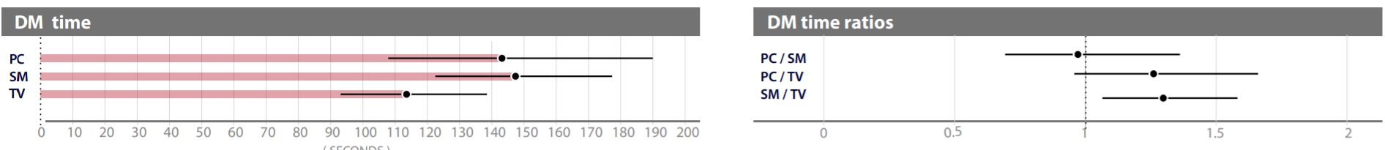
Experiment Results – Time-on-task for decision making
From the results there is evidence that users made decisions more rapidly with Tabular Visualizations.
Both Scatterplot Matrix and Parallel Coordinates visualizations took on average 1.3 times longer.

Slide 15
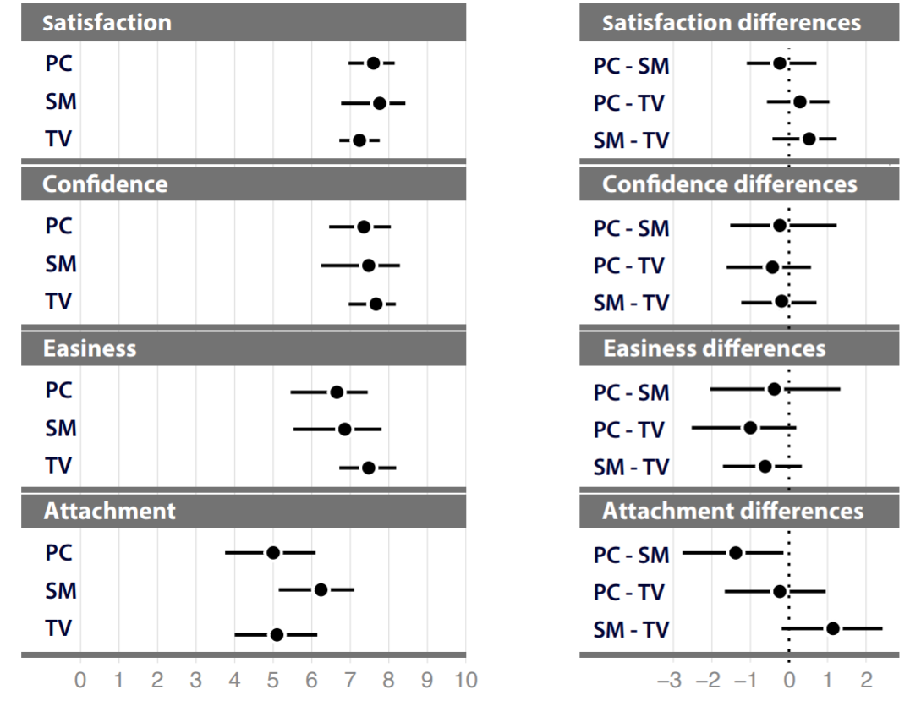
Results of experiment – Subjective choice assessment
Each horizontal panel presents the results according to a different choice metric. A positive value indicates a higher average rating.
Overall there is no evidence of a major difference of satisfaction between techniques.
They found the data to be inconclusive regarding participants confidence in their choice.
With perceived easiness the results suggest that decisions made with Tabular Visualization are easier.
It shows that participants are slightly more attached to their choice if made with a Scatterplot Matrix.

Slide 16
conclusion
The experiment focused on elementary and generic visualizations, which will hopefully inform the design and evaluation for more complex visualization tools targeted at decision support.
For all three visualizations types, each had near perfect accuracy.
Completion times varied between design techniques and it was found that Scatterplot Matrices were the fastest for correlation tasks but slowest for analytic tasks.
On average Tabular Visualizations performed most consistent and it outperforms Parallel Coordinates on time and accuracy.
For decision tasks, participants seemed more sure of choices made with Scatterplot matrices, but on average choices made with Tabular visualizations were faster.

Slide 17
Conclusion and more
https://aviz.fr/dm
:]

